Slide 1

Review of Radiation Physics
RTT4220 – Lecture #1
Kedree Proffitt
WSU
09/02/2025

Slide 2
Review of Electricity and Magnetism
The old stuff
Notes:
Common E&M Derived Values
Common Electricity Equations
Acceleration of Electrons
Atomic Mass Units

Slide 3
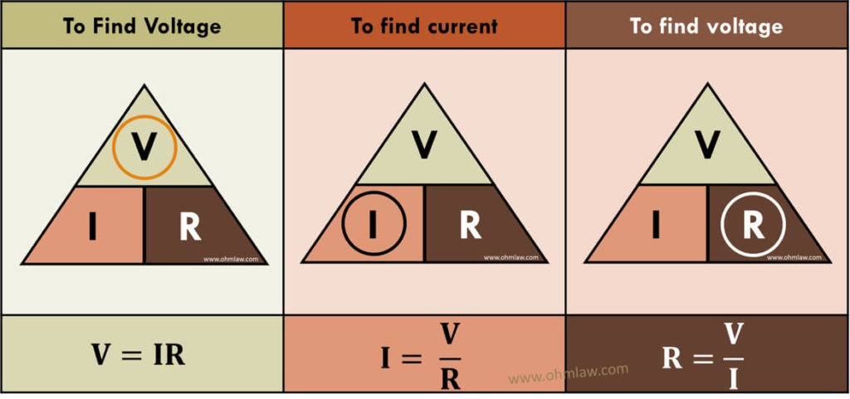

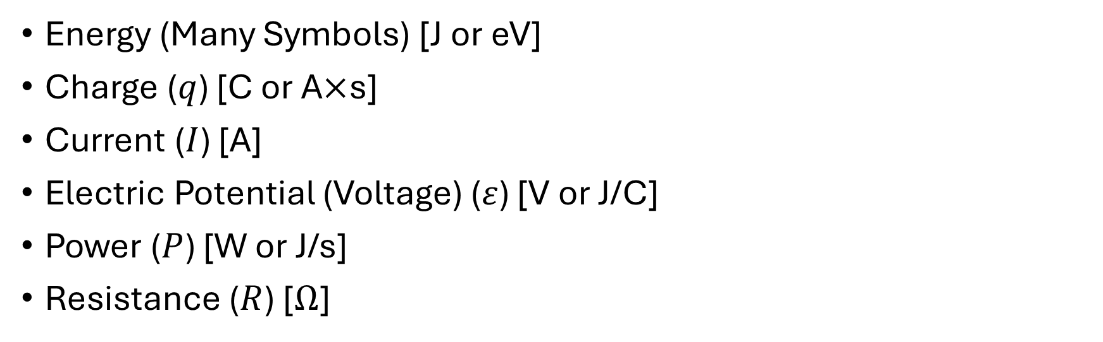


Electricity and Magnetism
Energy (Many Symbols) [J or eV]
Charge ($q$) [C or A$×$s]
Current ($I$) [A]
Electric Potential (Voltage) ($ε$) [V or J/C]
Power ($P$) [W or J/s]
Resistance ($R$) [$Ω$]
$$P=I×V$$
$$\text{KE}=q×ε=\frac{mv^{2}}{2}$$
$$V=I×R$$

Slide 4
Moving Electrons
When electrons accelerate → photons are generated
Acceleration can occur two ways; SPEED or DIRECTION
High speed accelerating electrons are awesome and dangerous: X-rays
We often want fast electrons, easiest way to get them is VOLTAGE
VOLTAGE gives electrons energy, makes them accelerate (charged particles)

Slide 5

Electron Energy and Speed Practice
An electron travels a 300 V electric potential ($ε=300$ V) has a typical mass ($m=9.1×{10}^{−31}$ kg) and a typical charge ($q=1.6×{10}^{−19}$); find the kinetic energy assuming it started at rest.
$$\text{KE}=q×ε$$
$$\text{KE}=\left(1.6×{10}^{−19}\right)×\left(300\right)=4.87×{10}^{−17} \text{J}$$
$$\left(2.73×{10}^{−28} \text{J}\right)×\left(\frac{1 \text{eV}}{1.6×{10}^{−19}}\right)=300 \text{eV}$$
Now find the velocity it had as it left the potential (ignore relativity).
$$\text{KE}=\frac{mv^{2}}{2}→v=\sqrt{\frac{2\text{KE}}{m}}→v=\sqrt{\frac{2×\left(4.87×{10}^{−17}\right)}{9.1×{10}^{−19}}}=10.3\frac{\text{m}}{\text{s}}$$

Slide 6
Atomic Mass Units
An atomic mass unit (amu) is 1/12th of the mass of a carbon-12 nucleus.
Carbon-12 has 6 protons and 6 neutrons and weighs 12 amu (by definition).
Protons and neutrons weigh ~ the same, each is about 1 amu
1 amu = 1.66E-27 kg

Slide 7
Radiation Physics
The good stuff
Notes:
What is Radiation
Types of Radiation
What is a photon
Photon Spectrum
Clearing up Photon vs Gamma vs Xray
Wave-Particle Duality
Common Photon Units
Calculating Photon Chars.

Slide 8
What is Radiation?
When energy radiates away from something (energy or mass)
Lots of misconceptions!
Many types of radiation and the uses/danger are just as variable
Light, Microwave, infrared, alpha, beta, gamma, the list goes on

Slide 9
Types of Radiation
ELECTROMAGNETIC
Photons (that’s it!)
The name depends on energy and/or source (i.e. Gamma/X-ray/Light)
PARTICULATE
Helium (Alpha)
Electrons (Beta)
Protons

Slide 10
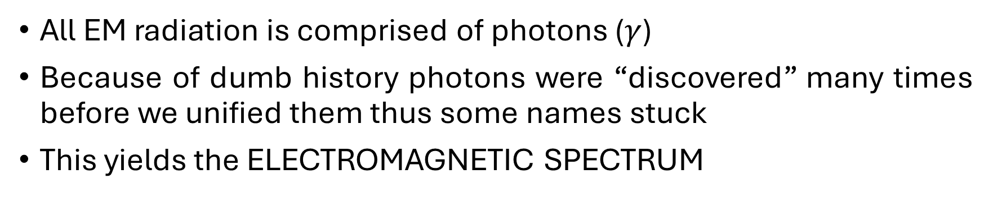
What is a Photon?
All EM radiation is comprised of photons ($γ$)
Because of dumb history photons were “discovered” many times before we unified them thus some names stuck
This yields the ELECTROMAGNETIC SPECTRUM
If it came from an atom*:
ITS GAMMA RADIATION*
If it came from anything else*:
WE DON’T HAVE A WORD*
But no matter what, it’s on the spectrum!

Slide 11
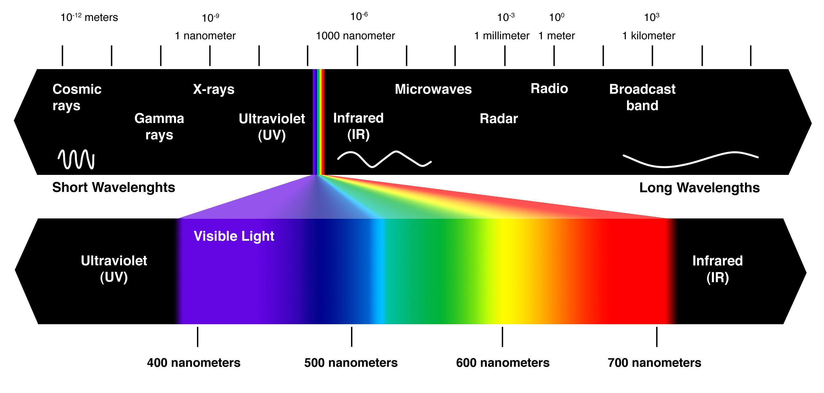


Electromagnetic Spectrum

Slide 12
Wave-Particle Duality
EM Radiation behaves in ways that determine it MUST BE particles, and it MUST BE waves at the same time.
?????
Its both due to quantum mechanics.
Wave-like Behavior:
Particles CANNOT diffract
We see EM rad. diffract!
Therefore, its wave-like!
Particle-like Behavior:
Waves CANNOT deposit energy in “batches”
EM rad. does so: photoelectric effect
Therefore, its particle-like!

Slide 13
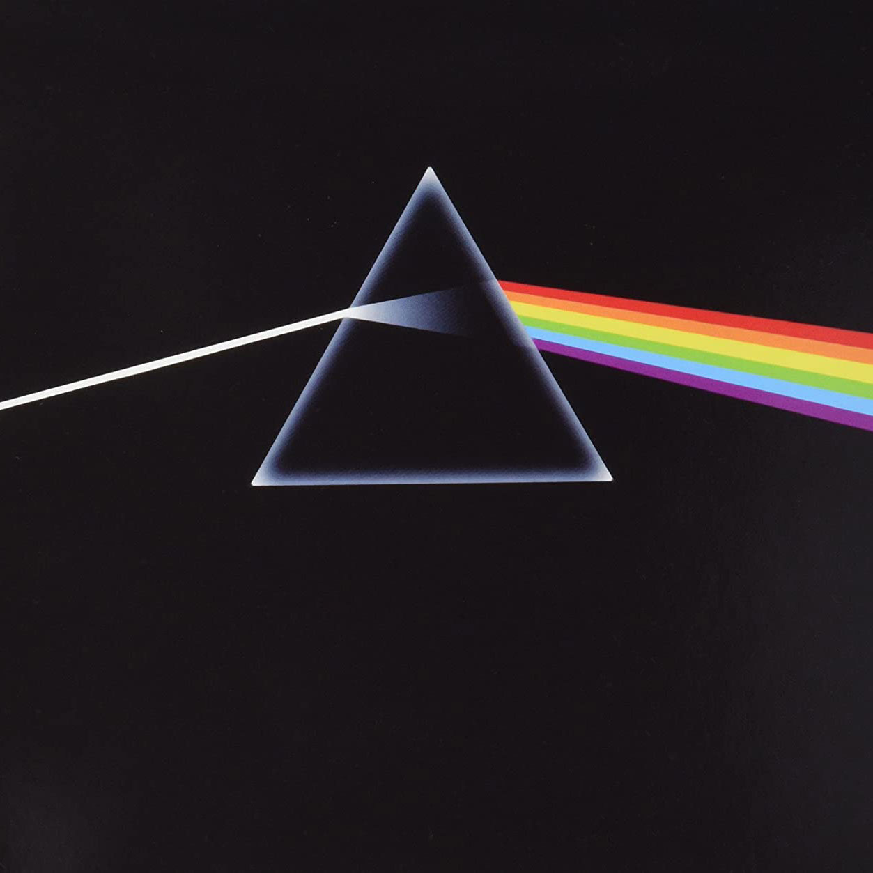
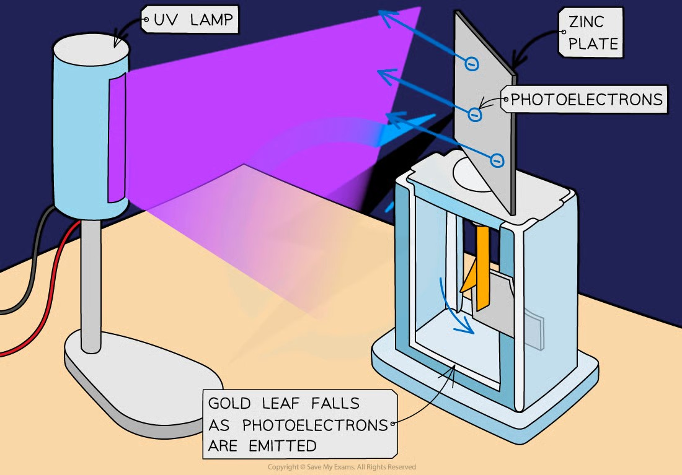
Wave-Particle Duality
Wave-Like
Particle-Like

Slide 14
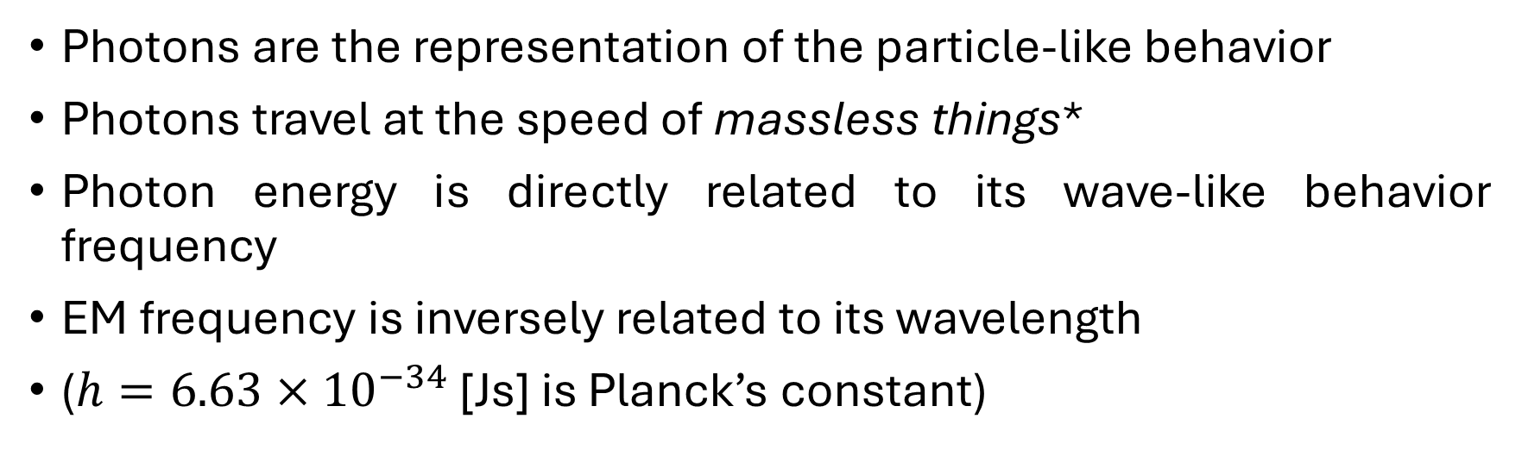



Photon Physics
Photons are the representation of the particle-like behavior
Photons travel at the speed of massless things*
Photon energy is directly related to its wave-like behavior frequency
EM frequency is inversely related to its wavelength
($h=6.63×{10}^{−34}$ [Js] is Planck’s constant)
$$E=h×ν$$
$$ν=\frac{c}{λ}$$
$$E\text{[}\text{kev}\text{]}=\frac{1.24}{λ\text{[}\text{nm}\text{]}}$$

Slide 15

Photon Energy Practice
An x-ray with a wavelength of 4.20E-9 m is ATTENUATED by a detector. How much energy would be deposited? What is the frequency of that radiation?
$$E=\frac{1.24}{4.2}=0.295 \text{keV} \text{OR}$$
$$E=\frac{h×c}{λ}→E=\frac{\left(6.63×{10}^{−34}\right)×\left(3×{10}^{8}\right)}{4.20×{10}^{−9}}×\frac{1 \text{eV}}{1.6×{10}^{−19}}=296 \text{eV}$$
How much energy would be deposited by 1 MILLION of these x-rays?
$$296×{10}^{6}=2.96×{10}^{8} \text{eV} \text{or} 296 \text{MeV}$$

